Slide 1
RNA-Seq with limma
SPH 247
Statistical Analysis of
Laboratory Data

Slide 2
limma-voom
We have seen how limma can fit a linear model to each gene in microarray
This is not limited to microarrays and can be used also with RNA-Seq data
The main problem is that the linear models used in limma assume that the error variance is equal at all levels
But in RNA-Seq, the variance rises with the mean
Voom applies weights to address this problem.

Slide 3
Bottomly Data
Two inbred mouse strains, C7BL6/6J (10 animals) and DBA/2J (11 animals)
Gene expression in striatal neurons by RNA-Seq and expression arrays.
36,536 unique genes of which 11,870 had a count of at least 10 across the 21 samples.
We can find differentially expressed genes with limma-voom

Slide 4
Data Files
bottomly_count_table.txt
36536 rows (genes) plus one header row of column names
22 columns, 1 column of gene names, 10 C7BL6, 11 DBA2
gene SRX033480 SRX033488 SRX033481 SRX033489
1 ENSMUSG00000000001 369 744 287 769
2 ENSMUSG00000000003 0 0 0 0
3 ENSMUSG00000000028 0 1 0 1
4 ENSMUSG00000000031 0 0 0 0
5 ENSMUSG00000000037 0 1 1 5

Slide 5
Data Files
bottomly_phenodata.txt
21 rows, one per sample
5 columns
sample.id num.tech.reps strain experiment.number lane.number
1 SRX033480 1 C57BL/6J 6 1
2 SRX033488 1 C57BL/6J 7 1
3 SRX033481 1 C57BL/6J 6 2
4 SRX033489 1 C57BL/6J 7 2
5 SRX033482 1 C57BL/6J 6 3
Three experiments (4, 6, 7), 7 lanes per experiment,
C7BL6 in lanes 6, 7, 8 of experiment 4
C7BL6 in lanes 1, 2, 3, 5 of experiment 6
C7BL6 in lanes 1, 2, 3 of experiment 7
Two possible factors: strain (intended) experiment number (block?)

Slide 6
Input code
source("input.bottomly.R")
tmp <- read.table("bottomly_count_table.txt",header=T) count.data <- tmp[, -1] rownames(count.data) <- tmp[, 1] min.count <- 21 count.data <- count.data[which(rowSums(count.data) >= min.count), ] data2 <- read.table("bottomly_phenodata.txt", header=T) strain <- factor(as.character(data2$strain))
exp.num <- factor(as.character(data2$experiment.number))
1) Reads count data from file
2) Eliminates gene names as a column, but adds them as row names
3) Filters data to eliminate genes with a mean count of less than one per
sample (11175 of 36536 genes retained)
4) Reads characteristics of the sample
5) Creates variables for strain and experiment number

Slide 7
Analysis Code
source("limma.analysis.R")
require(limma) require(edgeR) dge <- DGEList(counts=count.data, genes=rownames(count.data), group=strain) dge <- calcNormFactors(dge) design1 <- model.matrix(~strain) v1 <- voom(dge, design1, plot = TRUE) fit1 <- lmFit(v1, design1) fit1 <- eBayes(fit1)
1) Creates dge object
2) Normalizes
3) Design matrix from strain only
4) Log transform and apply variance weights with voom
5) Fits linear models to each gene
6) “Shrinks” variances

Slide 8
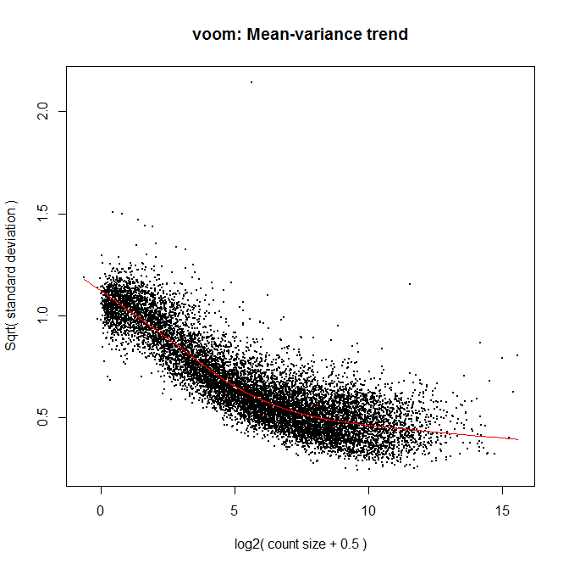

Slide 9
Results
> names(fit1)
[1] "coefficients" "stdev.unscaled" "sigma" "df.residual"
[5] "cov.coefficients" "pivot" "genes" "Amean"
[9] "method" "design" "df.prior" "s2.prior"
[13] "var.prior" "proportion" "s2.post" "t"
[17] "df.total" "p.value" "lods" "F"
[21] "F.p.value"
> colnames(fit1$p.value)
[1] "(Intercept)" "strainDBA/2J“
> hist(fit1$p.value[,2])
> sum(fit1$p.value[,2] < 1e-4)
[1] 385
> sum(p.adjust(fit1$p.value[,2],"fdr") < 0.05)
[1] 1011

Slide 10
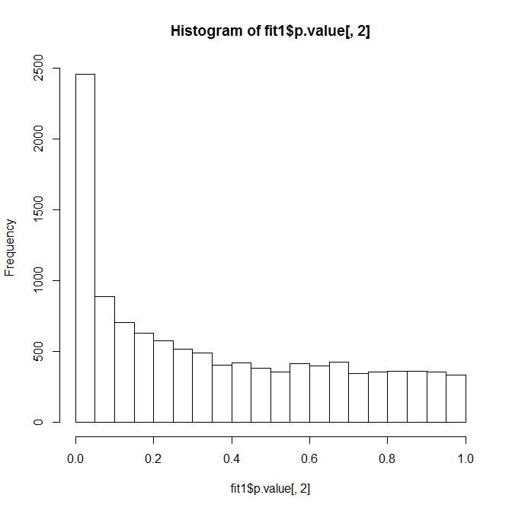

Slide 11
Exercise
Edit code so that exp.num is fit as well as strain.
Compare the number of FDR significant genes
What is the overlap?
design2 <- model.matrix(~exp.num+strain)
The p.value matrix will have four columns instead of 2.
Note that the blocking variables should be first in the formula if any kind of anova will be done.

